Slide 1


Speech Intent Recognition System Using Wav2Vec2
This project develops a speech intent recognition system that allows users to engage with machines using voice commands. Using Wav2Vec2, a state-of- the-art transformer-based model, we extract features directly from raw audio waveforms to understand spoken intents like "Turn off the lights" or "Set an alarm."
Our system offers real-time feedback through a lightweight, web-accessible
interface deployed via Gradio and Hugging Face Spaces. Fine-tuned on the
Fluent Speech Commands dataset, this project demonstrates the viability of
deep learning for real-time voice-based intent recognition.

Slide 2
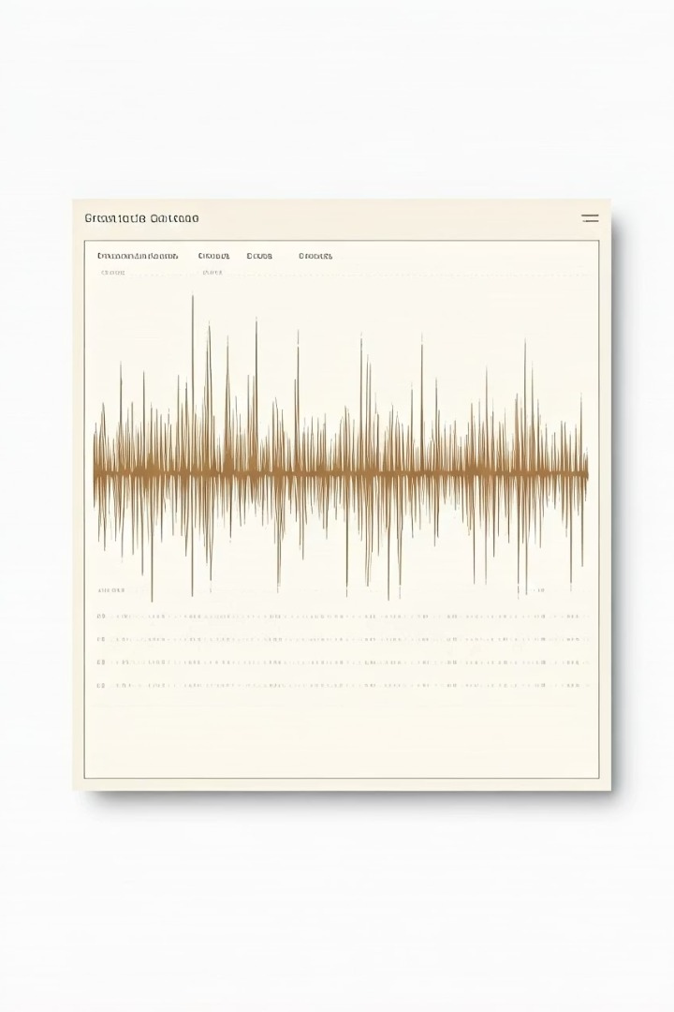








Understanding the Fluent Speech Commands Dataset
Dataset Size
30,043 utterances from 97 individuals (23 male, 74 female)
Audio Format
WAV files approximately 1-2 seconds each, sampled at 16kHz
Annotation Structure
Each utterance labeled with action (e.g., turn on), object (e.g., lights), and location (e.g., kitchen)
Intent Classification
31 unique intents formed by combinations of actions, objects, and locations

Slide 3






Wav2Vec2.0: Self-Supervised Speech Learning
Contextual Understanding
Transformer builds high-level contextual embeddings
Contrastive Learning
Masking spans of representations and solving prediction tasks
Feature Encoding
Convolutional encoder processes raw waveforms
Wav2Vec2.0 fundamentally reshapes how speech representations are extracted. The model first encodes raw waveforms using a convolutional feature encoder, then applies a transformer to build contextual embeddings. This eliminates dependence on large annotated corpora by learning general-purpose audio features from raw, unlabeled speech.

Slide 4
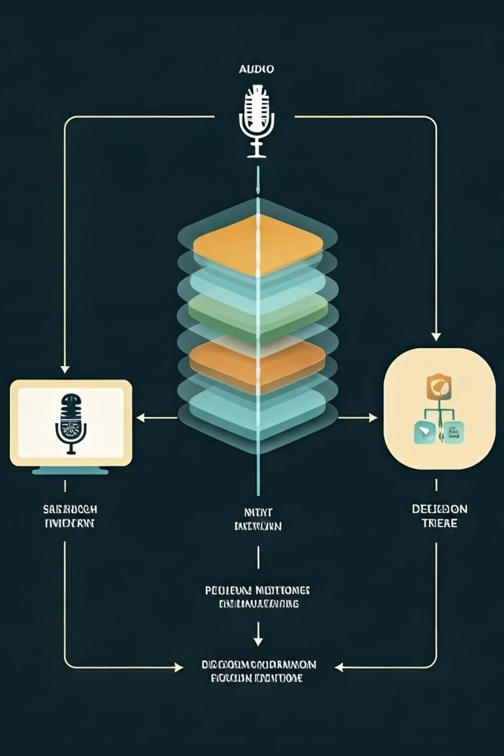


Deep Learning Pipeline Architecture
Data Preparation
Audio loading, resampling to 16kHz, and augmentation with noise and gain variation
Model Architecture
Wav2Vec2.0 backbone with attention mechanism and classification layer
Training Strategy
AdamW optimizer, learning rate scheduling, and early stopping
Real-Time Inference
Microphone input processing and intent prediction

Slide 5
Model Architecture Details
Wav2Vec2 Base
Pretrained facebook/wav2vec2-large model serves as the feature extractor, encoding raw waveforms into high- dimensional contextual representations using a deep Transformer encoder.
Custom Classification Head
Layer Normalization stabilizes feature distribution Attention mechanism assigns weights to each time step Dropout prevents overfitting Fully connected layer projects to 31 output classes
This leverages transfer learning from large-scale pretraining on
unlabeled speech data, providing robust speech
representations.

Slide 6
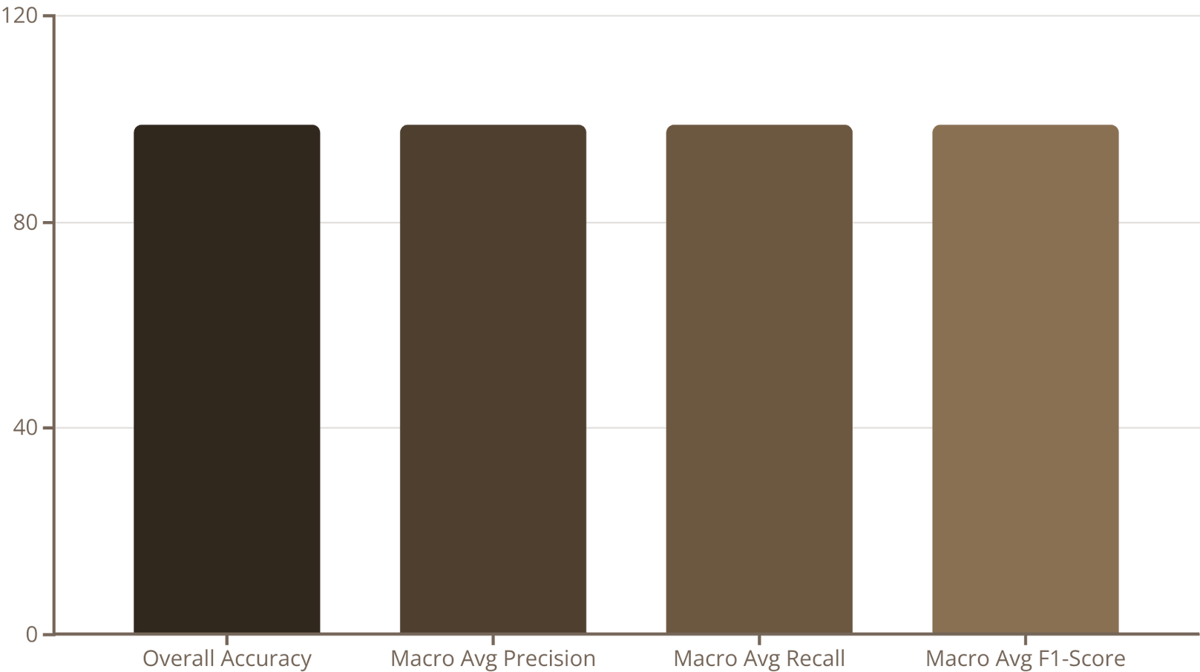
Performance Results

Slide 7
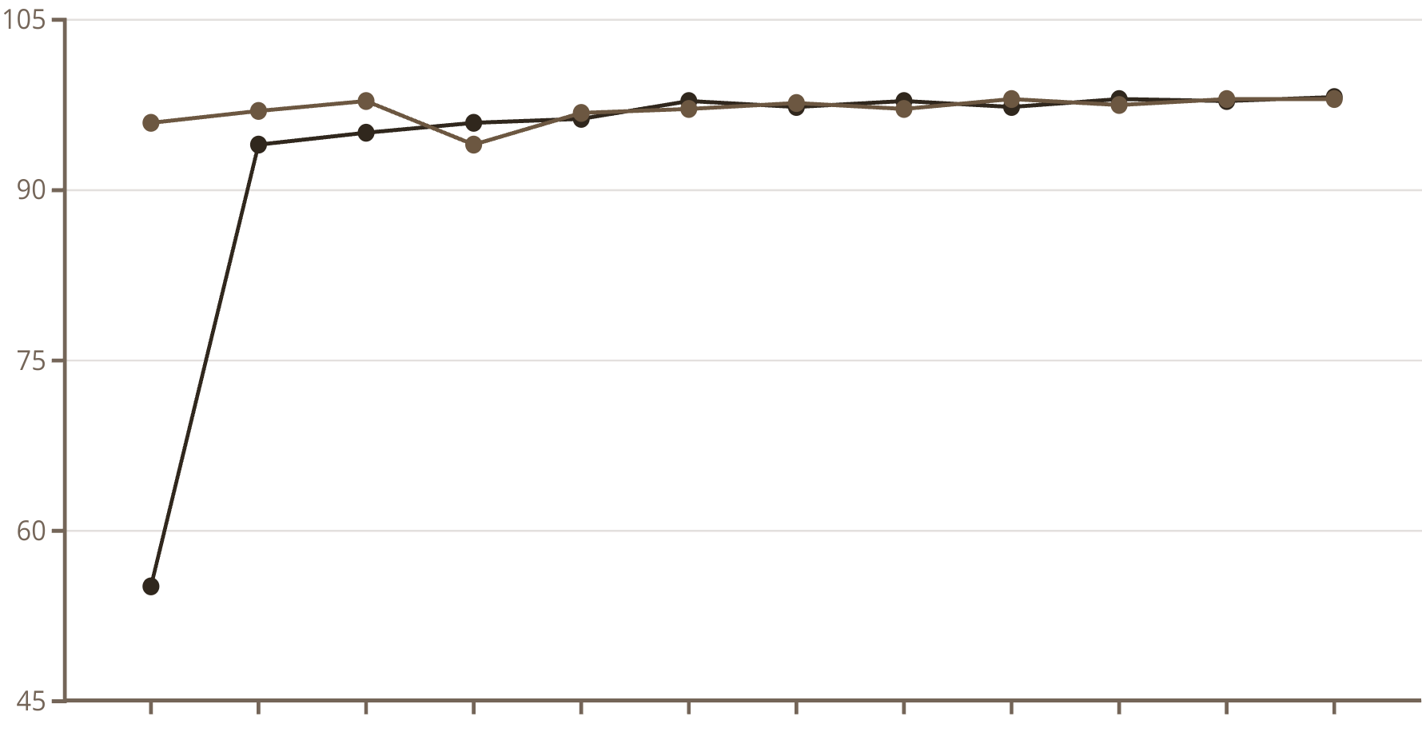
Training Convergence Analysis

Slide 8



Key Conclusions
Transfer Learning Effectiveness
Fine-tuning the pre-trained Wav2Vec2 model proved highly effective, leveraging pre-learned speech representations to enhance performance on specialized intent recognition tasks.
End-to-End Approach Viability
Direct mapping from raw audio to semantic intent, bypassing explicit transcription steps, was validated as a powerful approach for voice command
Robust Cross-Intent Performance
Consistent performance across all 31 intent classes demonstrates strong generalization capabilities and potential reliability in real-world applications.

Slide 9

Future Work Directions
Contextual & Multi-lingual Support
Enhance the model to maintain conversation context across multiple commands and extend recognition capabilities across multiple languages.
Performance Optimization
Robustness Improvements
Further testing in challenging acoustic conditions (background noise, multiple speakers, different accents) to validate real-world deployment readiness.
Expanded Intent Coverage
Extend the model to handle a broader range of intents beyond the 31 classes, incorporating more complex commands and domain- specific vocabulary.
Investigate model compression techniques (quantization, pruning, knowledge distillation) to reduce inference time while maintaining high accuracy.

Slide 10



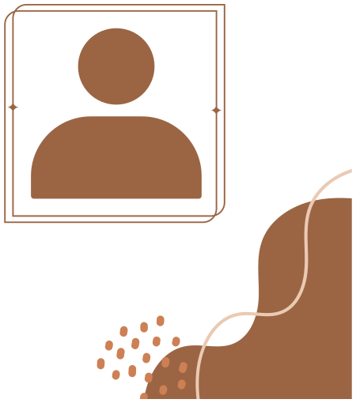




OUR TEAM
Hemant Dubey
Avi Parmar
Arnav Khanduja

